Slide 1
Actions And Action Execution
Getting Things Done

Slide 2
Definition
Actions, also called tasks or behaviours
Most primitive / atomic AI component
Four classes of action:
State change: change in world state e.g. open door
Animation: run an animation
Movement: steering or pathfinding
AI request: Making a request to another AI or lower level AI

Slide 3
Why Do We Need It
Often not discussed as distinct concept
But is a useful concept
Many AI algorithms e.g. decision trees, output an action
Actions can have internal states
Success or failure
Time to complete
Importance
This implies that an action should have distinct representation

Slide 4
Action Duration
Some actions are instantaneous
E.g. Issuing order to subordinate AI
But many require time to complete
E.g. movement
One action must complete before next can start
Also called blocking action
Means we must keep track of time
And indicate when action is complete

Slide 5
Interrupting Actions
World state may change before an action is complete
E.g. ambush during movement
AI must respond appropriately
Means actions must be interruptible
More important action should interrupt less important action
Need a representation of importance
Note that some actions e.g. jump, cannot be interrupted

Slide 6
Compound Actions
Some actions can be combined e.g.
Running and shooting
These actions may be triggered by different decision making processes
Thus not possible to predict combinations
Actions need to indicate whether they can be combined
Actions which can be combined can be executed in parallel

Slide 7
Action Sequences
Another class of compound action
Sequences related actions together
E.g. pull lever animation, followed by lever activation state change
Grouped together to simplify use
Also allows entire sequence to be checked for:
Interruptibility
Completeness
Combinability

Slide 8
Action Manager
As actions become more complex
Need to be managed
Useful to have an Action Manager component
Keeps track of current (active) action (or compound action)
And queues next action
Combines compound actions
Implemented as a queue
FIFO – First In, First Out

Slide 9
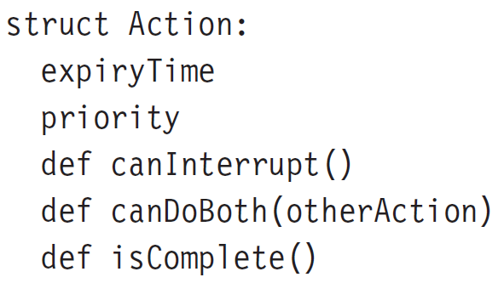
Action Class Pseudocode

Slide 10
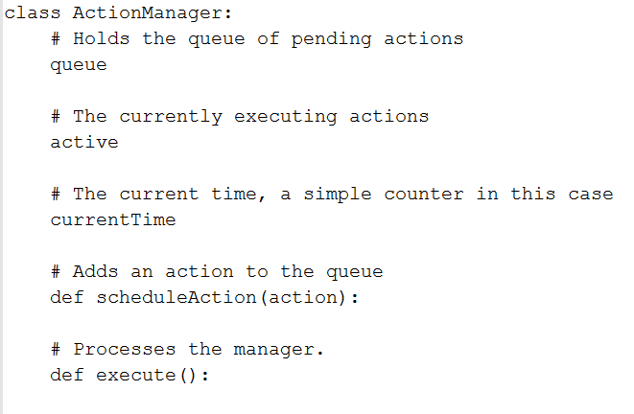
Action Manager Class Pseudocode

Slide 11
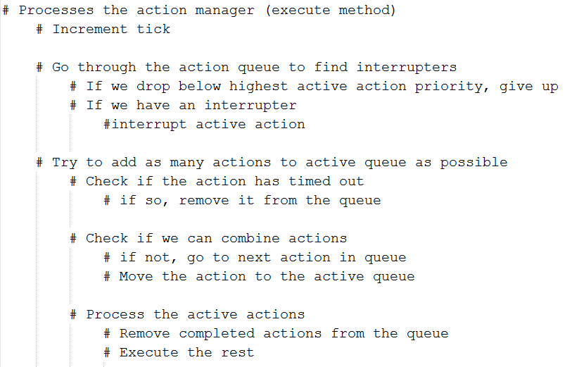
Action Manager Execute

Slide 12
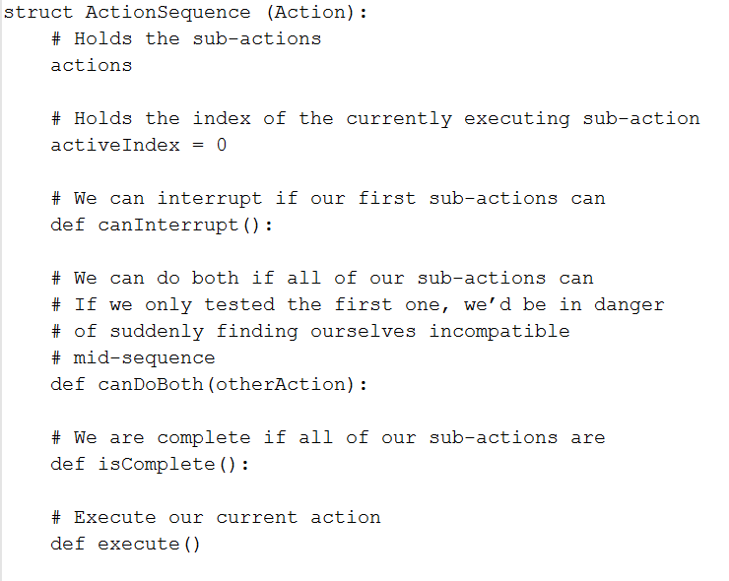
Action Sequence Class

Slide 13
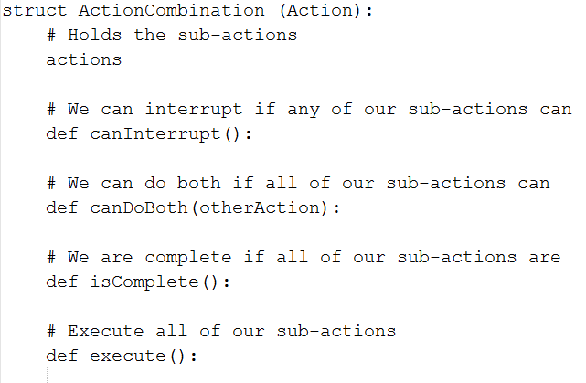
Compound Action Class

Slide 14
Pros And Cons
Easy to debug
Central location (action manager) for debugging
Allows compound actions to be treated as one
Easily combined with other algorithms
Can hit performance
Particularly when combining actions
Often not many actions in list though

